Slide 1
Bug-Squashers
Adrian Nechifor
Claudia grosu
Dumitru Procopovici
Florin Ciocirlan

Slide 2
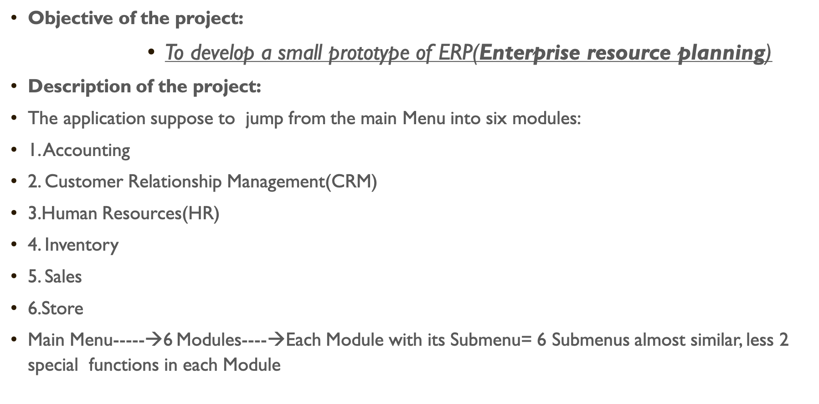
Lightweight ERP project

Slide 3
Module 1 | Module 2 | Module 3 | Module 4 | Module 5 | Module 6
Store manager | Human resources manager | Inventory manager | Accounting manager | Sales manager | Customer Relationship Management (CRM)
(1) Show table | (1) Show table | (1) Show table | (1) Show table | (1) Show table | (1) Show table
(2) Add new record | (2) Add new record | (2) Add new record | (2) Add new record | (2) Add new record | (2) Add new record
(3) Remove record | (3) Remove record | (3) Remove record | (3) Remove record | (3) Remove record | (3) Remove record
(4) Update record | (4) Update record | (4) Update record | (4) Update record | (4) Update record | (4) Update record
(5) Games of each manufacturer | (5) Get Oldest Person | (5) See available items | (5) Highest profit year | (5) Lowest price item | (5) Get Longest name id
(6) Average amount of games | (6) get Persons Closest to Average | (6) See average availability for each manufacturer | (6) Average profit in year | (6) Items sold in given time | (6) Get subscribed e-mails

Slide 4
Working calendar
ID | Module | Name | Description | Difficulty | Owner | Status | Completion Date
1 | UI | print table | Prints table with data. | 3 | Dima | In progress | 27.11.2019
2 |  | print result | Displays results of the special functions. | 1 | Claudia | Done | 26.11.2019
3 |  | print menu | Displays a menu. | 3 | Claudia | Done | 26.11.2019
4 |  | get inputs | Gets list of inputs from the user. | 3 | Dima plus all team | Done | 27.11.2019
5 |  | print error messages | Displays an error message (example: ``Error: @message``) | 1 | Claudia | Done | 26.11.2019
6 | Accounting |  |  |  | Adrian | In progress
7 | CRM | def start_module(): | Starts this module and displays its menu. * User can access default special features from here. * User can go back to main menu from here. |  | Claudia | In progress | 28.11.2017
 |  | def show_table(table): | Display a table |  |  |  | 29.11.2017
 |  | def get_longest_name_id(table): | Question: What is the id of the customer with the longest name? Args: table (list): data table to work on Returns: string: id of the longest name (if there are more than one, return the last by alphabetical order of the names) |  | Dima +Claudia |  | 29.11.2017
 |  | def get_subscribed_emails(table): | Question: Which customers has subscribed to the newsletter? |  | Dima +Claudia |  | 29.11.2017
 |  |  |  |  |  |  | 29.11.2017
 |  |  |  |  |  |  | 29.11.2017
 |  |  |  |  |  |  | 29.11.2017
8 | HR |  |  |  | Dima | In progress | 29.11.2017
9 | Inventory |  |  |  | Florin | In progress | 29.11.2017
10 | Sales |  |  |  | Adrian |  | 29.11.2017
 | Store |  |  |  | Adrian |  | 29.11.2017

Slide 5
CHALLENGES:
1. To understand the specifications.
2. to identify the starting point of coding
3. miss divisions of tasks
4. to match the functions
5. to fight with codewars ☺ ☺ ☺

Slide 6
Lessons learned:
1. Read twice before you take a decision.
2. sharing is caring.
3. deadlines didn’t work.
4. the skeleton of the project helped us a lot

